Slide 1
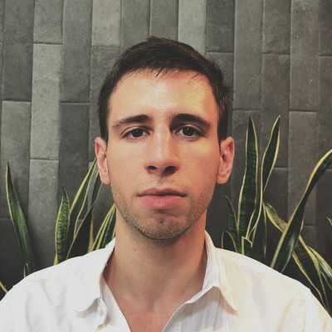

TEAM AND COMPANY
Ivan Damnjanovic – CEO (& [Team member])
Full time or Part-time: Full Time
Monthly Salary (S$): $4,500
Based in (Country): Singapore, Singapore
Experience: 5+ years
Name of Company: Ambient Systems Pte. Ltd.
ACRA Business No.: 202123300C
URL: https://www.ambientsystems.ai/
Incorporated in 05/Jul/2021
No. of Employees: 1
Name of Investors: National University of Singapore
Name of Advisors: Dr. [Team member], [Team member]
Total capital raised so far (S$): $140,000
Capital sought for this round(S$): $420,000 / US$300,000 (Gap: S$280,000)
For Equity (%) or SAFE: SAFE
Cash @ Bank (S$): $5,000
Total revenue to date (S$): $0
Current monthly revenues (S$): $0
Current monthly expenses (S$): $8,000
Total Grant(s) from Gov (S$): $0
Name of Grant(s): N/A
Outstanding Debt (S$): $0 ([Team member]s only)
Most Recent Capital Investment [MRCI](S$): $140,000
Equity Given for MRCI (%): post-valuation, no cap
Date for MRCI (%): N/A
Name of MRCI’s Investor: N/A
Current valuation (S$): TBD
Basis of Current valuation: TBD
[Team member] – Software Engineer
Full time or Part-time: Part Time
Monthly Salary (S$): $2,500 (up to $3,500)
Based in (Country): Toronto, Canada
Experience: 3+ years
TBC – Data Engineer
Full time or Part-time: Full Time
Monthly Salary (S$): $3,500 (up to $4,000)
Based in (Country): Singapore
Experience: 2+ years
TBC – Marketing Associate
Full time or Part-time: Full Time
Monthly Salary (S$): $1,500 (up to $2,500)
Based in (Country): Singapore
Experience: 2+ years

Slide 2
COMPETITORS
 | Ambient System’s SaaS Offering | Hire an External Consultancy | Build an In-house Team
Service | Ongoing Subscription with Dedicated Account Engineer | Fixed Project Duration Limited Maintenance Service Multiple Points of Contact | Hard to recruit Requires on-boarding Expensive training Management overhead High turnover risk
Cost | Fixed | Variable | Variable
Modelling | Based on domain expertise | Limited domain expertise | Requires multiple hard-to-find experts to tune Technical uncertainty and risk Expensive and complex IT vendor management process Cybersecurity risks

Slide 3

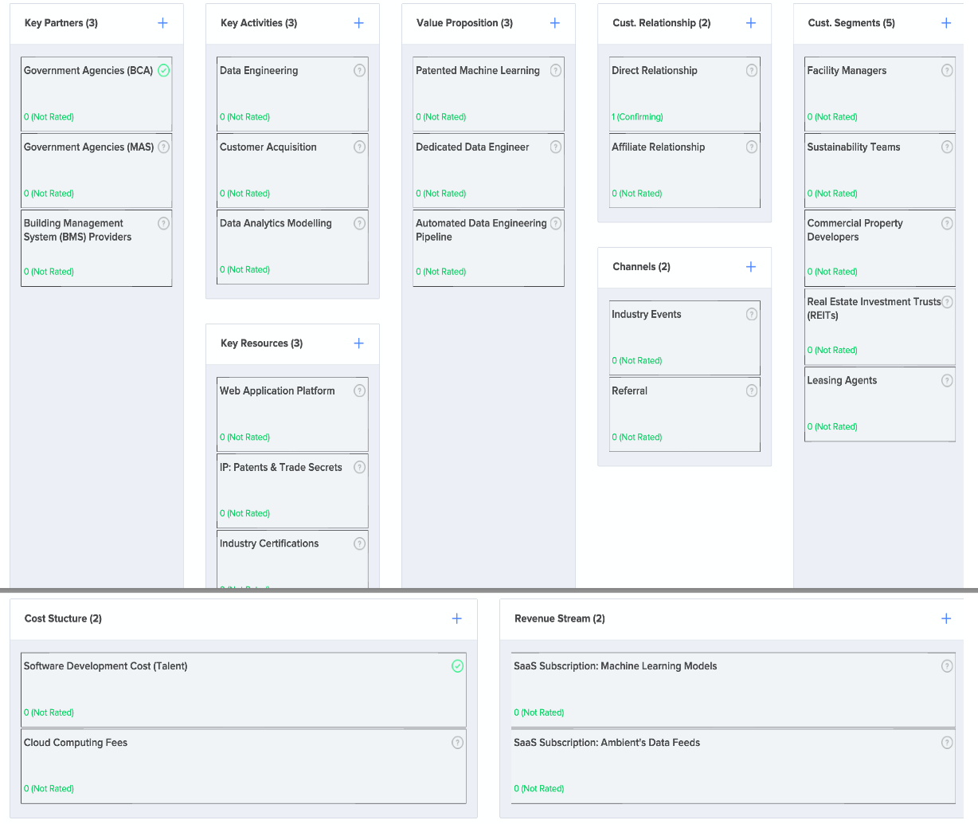




Solution, S
Outline a possible solution for each problem
Channels, C
List your path to customers;
Through which Channels do our Customer Segments
want to be reached?
How are we reaching them now?
How are our Channels integrated?
Which ones work best?
Which ones are most cost-efficient?
How are we integrating them with customer routines?
Revenue Stream, RS
List your sources of revenue:
Revenue Model
Lifetime Value
Revenue
Gross Margin;
For what value are our customers really willing to pay?
For what do they currently pay?
How are they currently paying?
How would they prefer to pay?
How much does each Revenue Stream contribute to overall revenues?
Problem, P
List your customer’s top 3 problems
Customer Segments, CS
List your target customers and users;
For whom are we creating value?
Who are our most important customers?
Cost Structure, CO
List your fixed and variable costs:
Customer Acquisition Costs
Distributed Costs
Hosting
People, etc.;
What are the most important costs inherent in our business model?
Unique Value Proposition, V
Single, clear compelling message that turns an unaware visitor into an interested product
Key Metrics, KM
List the key numbers that tell you how your business is doing
[Team member], UA
Something that can’t be easily copied or brought
Notes:
Background to Lean Canvas: https://leanstack.com/lean-canvas
Source of Lean Canvas Template: http://invcapital.com/pub/Lcanvas
Actual Examples:
-----------------------------------------------------------------------------------------------------------------
Recommended sequence of Inputs: P -> CS -> V -> S -> C -> RS -> CO -> KM -> UA
Versions: 2016: v1 © Dr. [Third party] dr(at)ye.sg

